Slide 1
Core Spring Framework
Water the Root
Notes:
last update: 4/3/2013

Slide 2
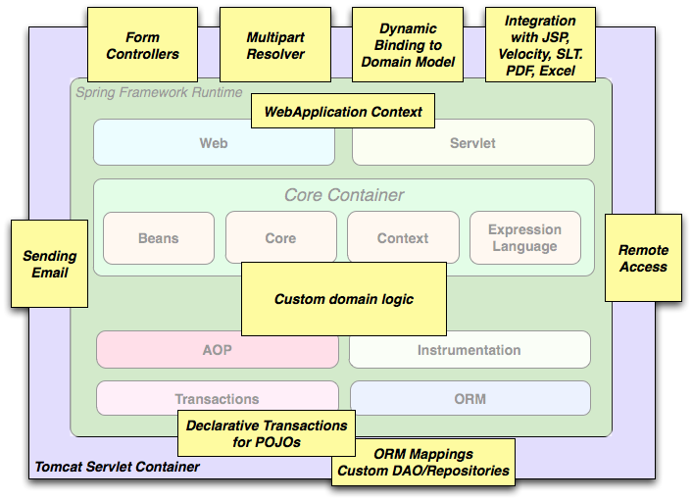
Spring Core

Slide 3
Spring Core Technologies
Core Technologies
Technologies absolutely integral to the Spring Framework.
Foremost is the Inversion of Control (IoC) container.
IoC ***
Inversion of Control Container
AOP ***
Aspect-Oriented Programming
Validation***
Data Validation W/pluggable interface
SpEL **
Spring Expression Language that supports querying and manipulating an
object graph at runtime.
Resource **
Common API that abstracts the type of underlying resource
such as a URL, file or class path resource.
Notes:
Validation & Data Binding -- Testing
http://docs.spring.io/spring/docs/current/spring-framework-reference/html/spring-core.html

Slide 4
Inversion of Control [IOC]
Objects do not create other objects that they
depend on.
Promotes loose coupling between classes and subsystems
Adds potential flexibility to a codebase for future changes.
Classes are easier to unit test in isolation.
Enable better code reuse.

Slide 5
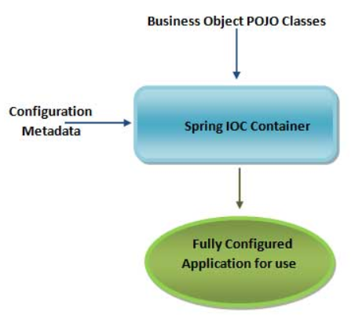
Spring Core – IoC Container
The Essence of a Spring Application
Notes:
POJOs are ACTUAL application
Need to CONFIGURE it to be SPRING managed
Spring Provides the Infrastructure
END Product is the BUSINESS APP

Slide 6
The CORE of Spring Core
The HEART of the Spring Framework is the
Spring Inversion Of Control [IOC]
Container
The IOC container is used to Manage & Configure
Plain Old Java Objects [POJO]
Through
Interfaces [usually] **
** A Class can be Managed & Configured. However you lose some of the advantages[Testing, etc.]

Slide 7
JavaBeans .vs. POJO .vs. Spring Bean
JavaBean
Adhere to Sun’s JavaBeans specification
Implements Serializable interface
public no-argument [default] constructor
Reusable Java classes for visual application composition
POJO
‘Fancy’ way to describe ordinary Java Objects
Doesn’t require a framework
Doesn’t require an application server environment
Simpler, lightweight compared to ‘heavyweight’ EJBs
Spring Bean
Spring managed - configured, instantiated and injected
A Java object can be a JavaBean, a POJO and a Spring bean all at the same time.
Spring Documentation:
“Component” is used interchangeably with POJO class
Both mean a Java class from which an object instance is created .
Spring Documentation:
“Bean” is used interchangeably with POJO instance
Both mean object instance created from a Java class.
Notes:
What does Spring actually “manage”? - our code!!! – POJOs… vs EJB..

Slide 8
Inversion of Control [IOC]
"Hollywood Principle: Don't call us, we'll call you".
The terms IOC and Dependency Injection [DI] are often used interchangeably.
IOC actually refers to:
Dependency Lookup
&
Dependency Injection
Lookup involves a “pull” of the dependency from a resource: e.g. Registry Lookup
For injection, IOC container “pushes” the dependency…

Slide 9
Dependency Injection [DI]
Reduces “glue” code
Less setup of dependency in component
Simplifies Configuration
Declaratively re-configure to change implementations
Improves Testability
Substitute “mock” implementations
Fosters good design
Design to Interfaces….
Notes:
Why use !!!
Property file values into an bean DO NOT use BEAN declaration for string !!!
private @Value("${propertyName}") String propertyField;
@PropertySource("classpath:/com/myProject/config/properties/database.properties")
@Autowired private Environment env;
env.getProperty("database.connection.driver")
XML property == setter injection ---- constructor-arg is constructor

Slide 10
Main Point
The Inversion of Control Container manages the lifecycle for the objects required by our application, allowing us to focus on the functionality of our logic and giving flexibility for future implementations.
Science of Consciousness: Through the holistic field of life, the full range of life, the pure nature of creative intelligence, we can enrich all aspects of life.

Slide 11
Hello World
Who has NOT seen it?
package edu.mum;
public class HelloWorld {
public static void main(String[] args) {
System.out.println("Hello World!");
}
}
BUT the Message is HARDCODED!
As is the Display Mechanism!
Let’s IMPROVE the Design
Notes:
EXAMPLES -- DEMOs
Hardcoded Message = “Hello World!“
Hardcoded Display= System.out.println

Slide 12
Externalize the Message & Display Mechanism
import edu.mum.component.MessageDisplay;
import edu.mum.component.MessageSource;
import edu.mum.component.impl.HelloWorldMessageSource;
import edu.mum.component.impl.StandardOutMessageDisplay;
public class HelloWorldReDesigned {
public static void main(String[] args) {
MessageDisplay messageDisplay = getMessageDisplay();
MessageSource messageSource = getMessageSource();
messageDisplay.setMessageProvider(messageSource);
messageDisplay.display();
}
private static MessageDisplay getMessageDisplay() {
return new StandardOutMessageDisplay();
}
private static MessageSource getMessageSource() {
return new HelloWorldMessageSource();
}
NOTE: These are Interfaces
These are Implementations
BUT WAIT! – This is pretty COMPLEX!! LOTS of Coding!!
AND – the IMPLEMENTATIONS are STILL HARDCODED!!!
Notes:
NOTE: we Render the MESSAGE through the DISPLAY mechanism

Slide 13
Add Configuration to “externalize” the resources
public class MessageConfiguration {
private static final MessageConfiguration instance= new MessageConfiguration();
public static MessageConfiguration getInstance() { return instance; }
private MessageConfiguration() {
properties = new Properties();
String fileName = "HelloWorld.properties";
InputStream input=
getClass().getClassLoader().getResourceAsStream(fileName);
properties.load(input);
String displayClass = properties.getProperty("display.class");
String sourceClass = properties.getProperty("source.class");
display = DisplayFactory.getInstance(displayClass);
source = SourceFactory.getInstance(sourceClass);
}
Get components “declaratively” from properties file
Use Reflection API to create component instances

Slide 14
Add Configuration [Cont.]
import edu.mum.component.MessageDisplay;
import edu.mum.component.MessageSource;
import edu.mum.configuration.MessageConfiguration;
public class HelloWorldReDesignedWithConfiguration {
public static void main(String[] args) {
MessageConfiguration messageConfiguration=
MessageConfiguration.getInstance();
MessageDisplay messageDisplay = messageConfiguration.getMessageDisplay();
messageDisplay.display();
}
}
Here’s the “NEW” Look
Lookin’ GOOD – BUT lots of “glue” code…
Reading configuration file,
manually setting messageSource in messageDisplay, etc…

Slide 15
Spring Solution
package edu.mum;
public class HelloWorld {
public static void main(String[] args) {
ApplicationContext context=
new ClassPathXmlApplicationContext("spring/applicationContext.xml");
MessageDisplay messageDisplay= context.getBean("display",MessageDisplay.class);
messageDisplay.display();
}
}
SEE Demo HelloWorldSpringX
IOC – Dependency Lookup

Slide 16
Spring Solution
XML based Configuration
<?xml version="1.0" encoding="UTF-8"?>
<beans xmlns="http://www.springframework.org/schema/beans"
xmlns:xsi="http://www.w3.org/2001/XMLSchema-instance"
xmlns:p="http://www.springframework.org/schema/p"
xsi:schemaLocation="http://www.springframework.org/schema/beans
http://www.springframework.org/schema/beans/spring-beans.xsd">
<bean id="source" class="edu.mum.component.impl.HelloWorldMessageSource"/>
<bean id="display" class="edu.mum.component.impl.StandardOutMessageDisplay"
p:messageSource-ref="source"/>
</beans>
Spring manages components
Spring “injects” source dependency [DI]

Slide 17
Spring Configuration Metadata
XML based
  Wire components without touching their source code or recompiling them.
  CLAIM: Annotated classes are no longer POJOs ****
  Configuration centralized and easier to control.
Annotation [Version 2.5]
  Component wiring close to the source
  Shorter and more concise configuration.
JavaConfig [Version 3.0]
  Define beans external to your application classes by using Java rather than XML files
Annotation injection is performed before XML injection. Therefore XML injection takes precedence over Annotation injection. It is the “last word”
You can Mix and Match ’em

Slide 18
Annotation Based JavaConfig
Configuration
SOURCE: JavaConfiguration.java
@Configuration
// search the edu.mum.component package for @Component classes
@ComponentScan("edu.mum")
public class JavaConfiguration { }
_________SOURCE: StandardOutMessageDisplay .java_____________
@Component
public class StandardOutMessageDisplay implements MessageDisplay {
@Autowired
private MessageSource messageSource;
SEE Demo HelloWorldSpringAJ
Spring manages Annotated @Components
Spring Injects @Autowired dependencies

Slide 19
Annotation Based JavaConfig [Cont.]
@Component
public class HelloWorld {
@Autowired
MessageDisplay messageDisplay;
public static void main(String[] args) {
ApplicationContext applicationContext = new
AnnotationConfigApplicationContext( JavaConfiguration.class );
applicationContext.getBean(HelloWorld.class)
.mainInternal(applicationContext);
}
private void mainInternal(ApplicationContext applicationContext) {
messageDisplay.display();
}
} SEE Demo HelloWorldSpringAJ

Slide 20
Annotations with XML Config –
How to Scan
<beans xmlns="http://www.springframework.org/schema/beans"
xmlns:context="http://www.springframework.org/schema/context"
xmlns:xsi="http://www.w3.org/2001/XMLSchema-instance"
xsi:schemaLocation="http://www.springframework.org/schema/beans
http://www.springframework.org/schema/beans/spring-beans.xsd
http://www.springframework.org/schema/context
http://www.springframework.org/schema/context/spring-context.xsd">
<context:component-scan base-package= "edu.mum" />
</beans>
SEE Demo HelloWorldSpringAX

Slide 21
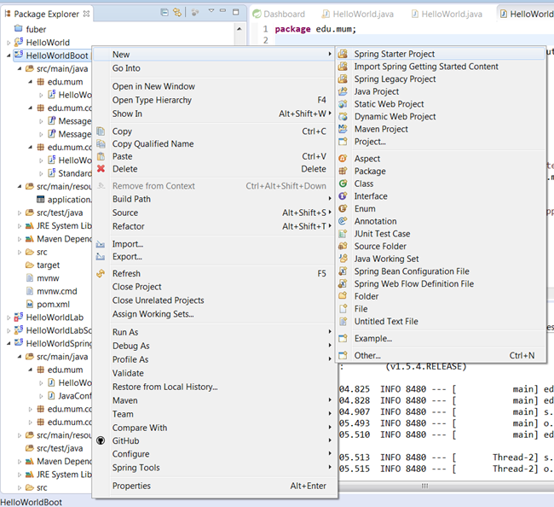
Spring Boot Project

Slide 22
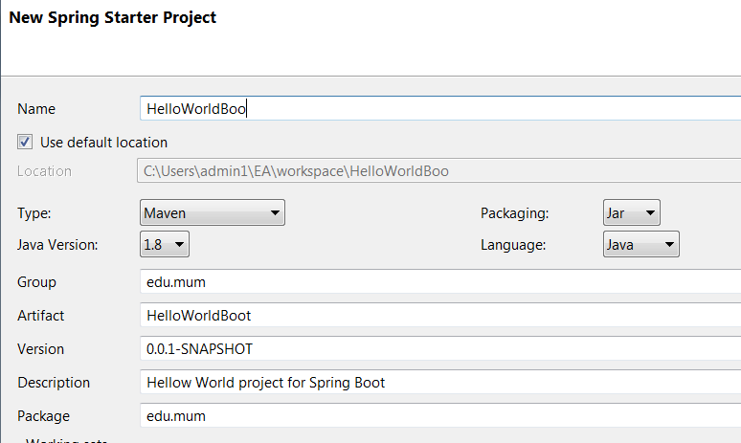
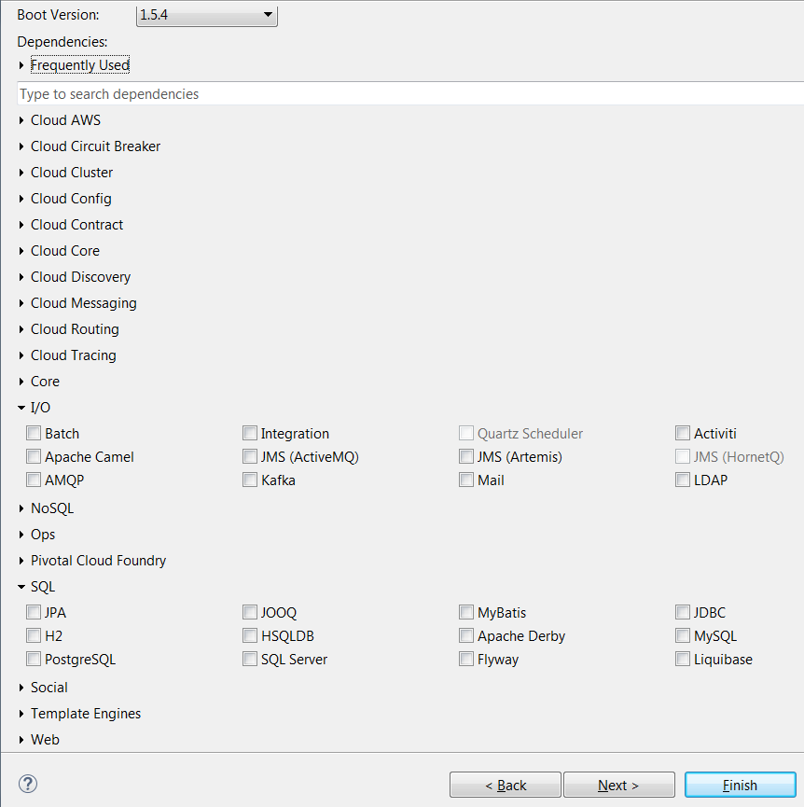
New Spring Boot
Project

Slide 23
Spring Boot Example
@SpringBootApplication
public class HelloWorld {
@Autowired
MessageDisplay messageDisplay;
public static void main(String[] args) {
// SpringApplication.run() -- startup/configure framework -- using THIS class !!!
ConfigurableApplicationContext applicationContext =
SpringApplication.run(HelloWorld.class, args);
applicationContext.getBean(HelloWorld.class).mainInternal(applicationContext);
}
private void mainInternal(ApplicationContext applicationContext) {
messageDisplay.display();
}
Looks Similar to Java Config

Slide 24
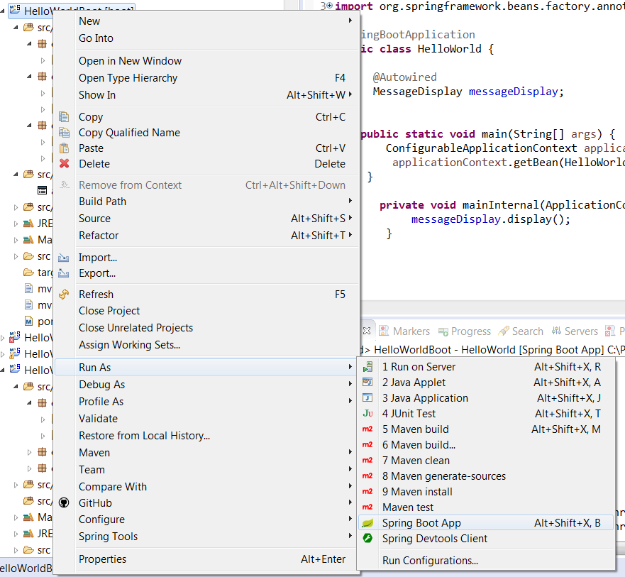
Run As Boot Application

Slide 25
Dependency Injection Annotations
Annotation | Package | Source
@Resource | javax.annotation | JSR 250
@Inject | javax.inject | JSR 330
@Autowired | org.springframework.bean.factory | Spring
@Qualifier ** | javax.inject | JSR 330
Name a component example –
@Autowired @Component(“production”)
@Qualifier(“production") public class MemberService implements MemberService
private MemberService MemberServiceImpl;
Notes:
JSR 330: Dependency Injection for Java.
JSR-250 Common Annotations for the JavaTM Platform
These 3 are the same:
@Resource(name="person")
@Autowired @Qualifier("person")
@Inject @Qualifier("person")
You may argue that they can be equal concise if you use the field name to identify the bean name.
@Resource private Party person;
@Autowired private Party person;
@Inject private Party person;

Slide 26
Named Component Comparison
Examples
@Autowired
@Qualifier(“production")
private MemberService memberService;
@Inject
@Qualifier(“production")
private MemberService memberService;
@Resource(name="production")
private MemberService memberService;
Referenced Component:
@Component(“production”)
public class MemberServiceImpl implements MemberService

Slide 27
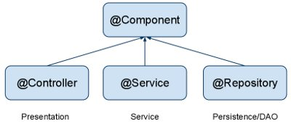
Spring Component Annotations
@Component is a generic stereotype for any Spring-managed component. @Repository, @Service, and @Controller are specializations of @Component for more specific use cases, for example, in the persistence, service, and presentation layers, respectively.

Slide 28
Dependency Injection [DI] placement
DI exists in three major variants
Dependencies defined through:
  Property-based dependency injection.
  Setter-based dependency injection.
  Constructor-based dependency injection
Container injects dependencies when it creates the bean.

Slide 29
Dependency Injection examples
Property based[byType]:
@Autowired
ProductService productService;
Setter based[byName]:
ProductService productService;
@Autowired
public void setProductService(ProductService productService){
this.productService = productService;
Constructor based:
ProductService productService;
@Autowired
public ProductController(ProductService productService) {
this.productService = productService;
Notes:
@Value
XML based:
no – Default, no auto wiring, set it manually via “ref” attribute … uses SETTER
byName – Auto wiring by property name. If the name of a bean is same as the name of other bean property, auto wire it.
byType – Auto wiring by property data type. If data type of a bean is compatible with the data type of other bean property, auto wire it.
constructor – byType mode in constructor argument.
autodetect – If a default constructor is found, use “autowired by constructor”; Otherwise, use “autowire by type”.
default-autowire=”byType” in XML

Slide 30
When do we use DI?
MAINLY when referencing components BETWEEN layers
Also
When an object references another object whose implementation might change
  You want to plug-in another implementation
When an object references a plumbing object
  An object that sends an email
  A DAO object
When an object references a resource
  For example a database connection
Notes:
We don’t want to use DI for all objects that we need to wire together. But where should we use DI, and where shouldn’t we use DI?
We can ask the same question for interfaces. When does an object get an interface, and when not? We do not just give all objects an interface. We only give an object an interface when we need flexibility, when we want to change the implementation of that object.
The same rule applies for Dependency Injection. We only apply DI where we need flexibility in wiring beans together. In general, cases where we need this kind of flexibility are:
When an object references another object whose implementation might change. An example of this is a service object or a Façade object that implements the interface of a component.
When an object references a plumbing object. An example of such a plumbing object is a DAO object, an object that sends a JMS message or an email message, an object that reads an XML file, etc.
When an object references a resource such as a database connection.

Slide 31
Main Point
Dependency Injection allows us to support better separation of concerns and creates more malleable applications with minimal effort.
Science of Consciousness: The experience of transcending gives us a better understanding of the order and flexibility in life in an effortless way.

